Slide 1


Bonjour,
I am pleased to know that you are going to join my French classes very soon. I hope you are also looking forward it.
I will make sure that you can catch up with the work in class, however it would be easier for you if you work through this powerpoint before you join your new group.
So far, the students have learnt how to greet people and how to be polite in French. They have also learnt the French alphabet, numbers from 1 -69, the days of the weeks and the months and finally they have learnt how to talk and write about their birthday and their age.
The vocabulary you need to learn is on these slides. Learn their meanings, their spellings and their pronunciation.
A Bientôt!
Mademoiselle Pszonak

Slide 2

Communicating with clarity and precision
Greetings in French

Slide 3
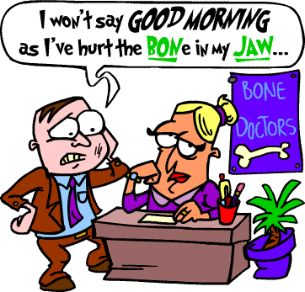

Greetings
Match the French words with the English words:
You can type these words in Google Translation and you can listen to their pronunciation!

Slide 4

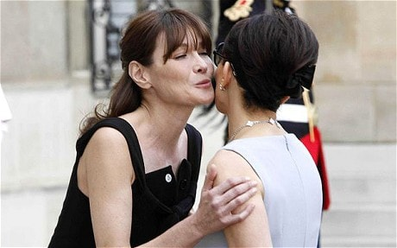
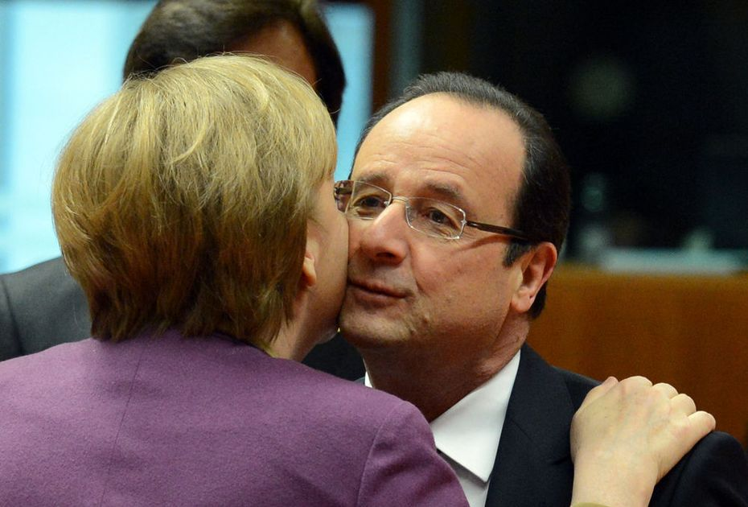
Complete the text using the words in the box:

Slide 5
Communicating with clarity and precision
The French alphabet

Slide 6
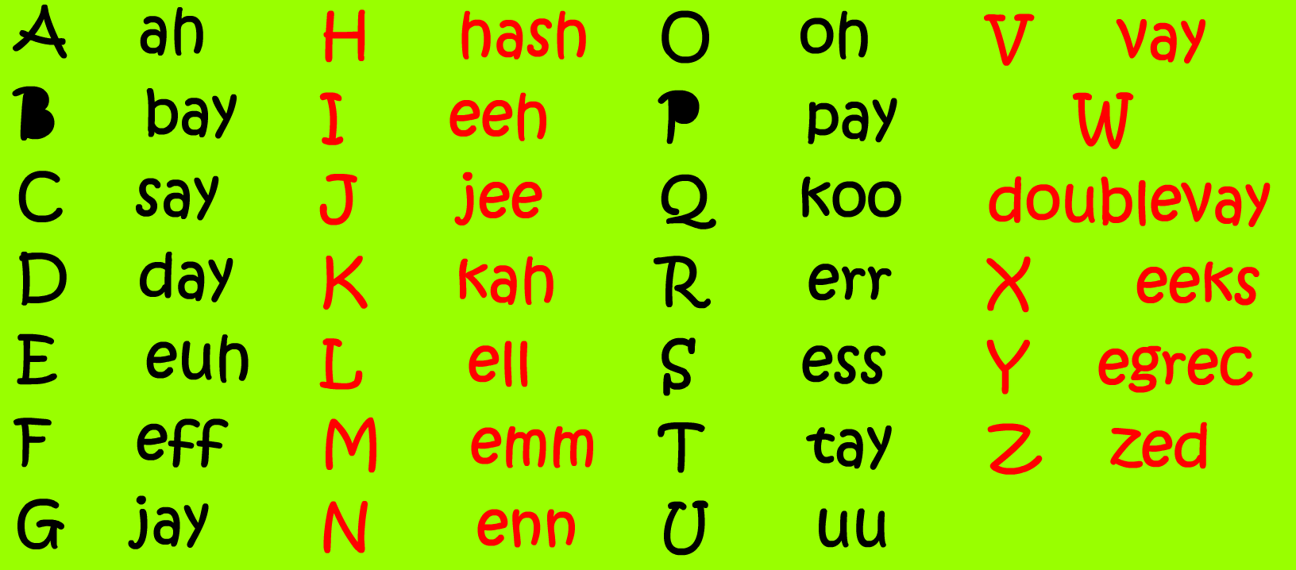
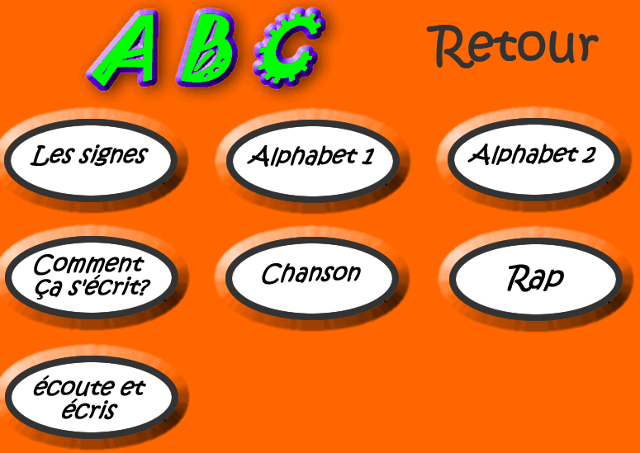
(hyperlink)

Slide 7
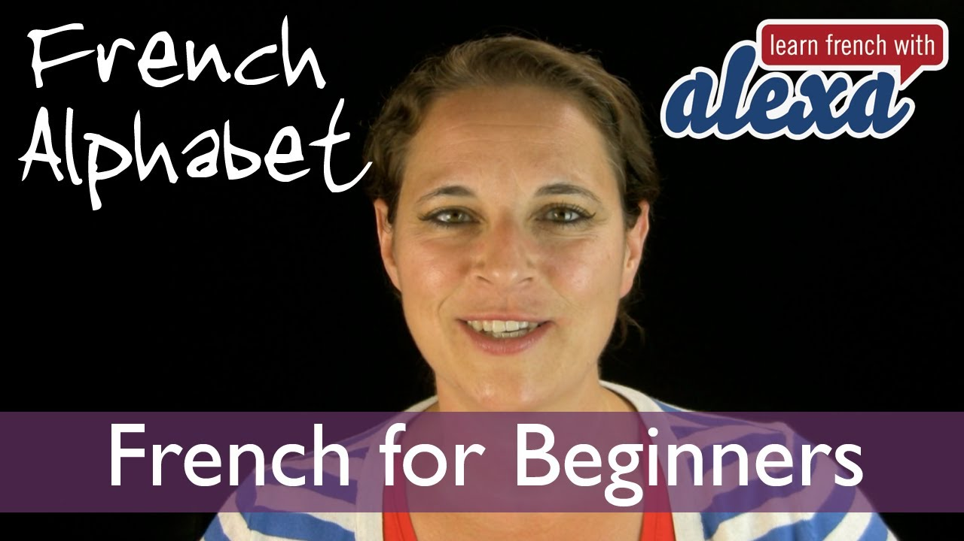
Practise the pronunciation on Youtube
The French Alphabet (Learn French With Alexa's French Essentials - vol. 1 - Lesson 3)

Slide 8
Striving for Accuracy
The numbers

Slide 9
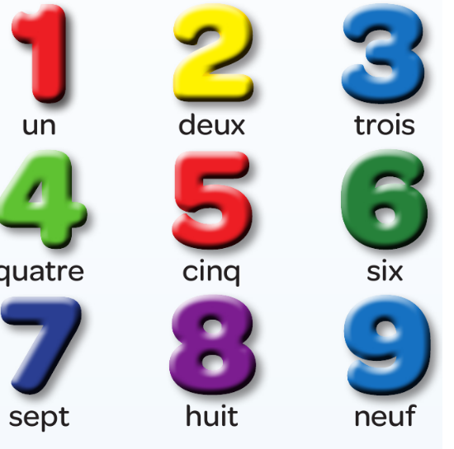
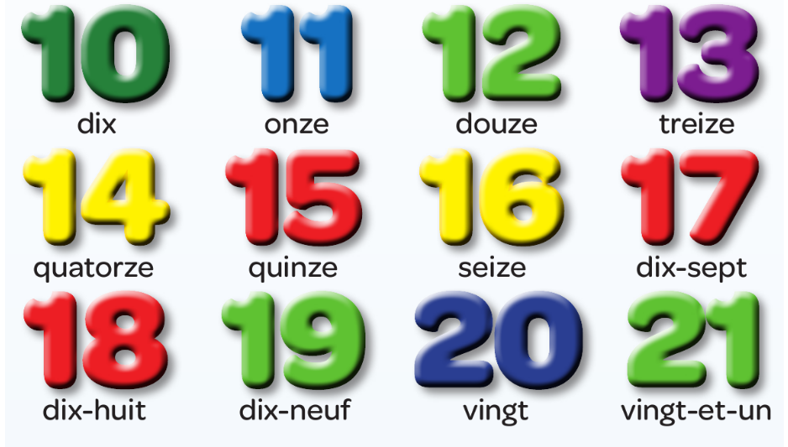
To practise the pronunciation of each number,
Go on the following website:
www.activeteachonline.co.uk/view
And enter the code:
GjnDnnHJ

Slide 10
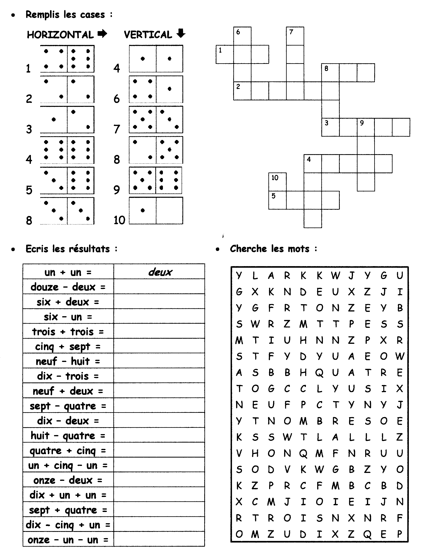
Devoirs

Slide 11
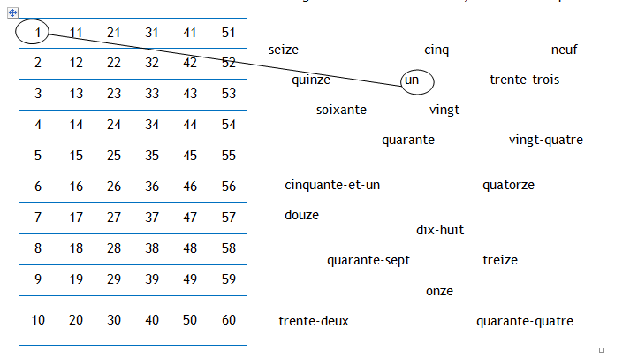

Slide 12
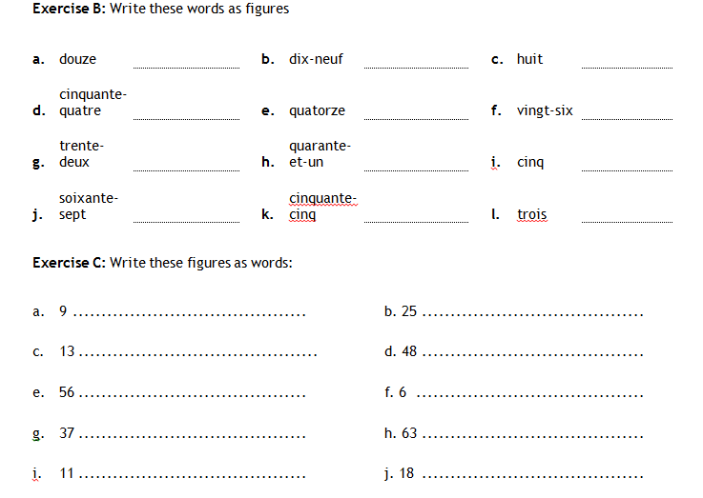

Slide 13
Striving for Accuracy
The days of the week and the months

Slide 14

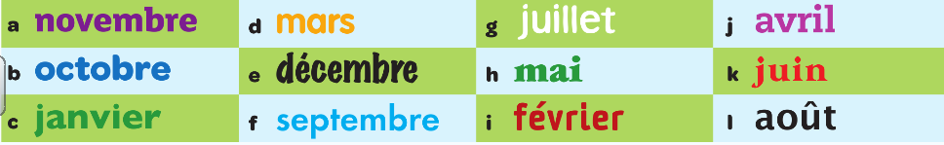
Striving for Accuracy

Slide 15
Communicating with clarity and precision
How to say your age and when your birthday is

Slide 16

Quelle est la date de ton anniversaire?
La date de mon anniversaire est le 6 novembre.
You can type these sentences in Google Translation and you can listen to their pronunciation!

Slide 17

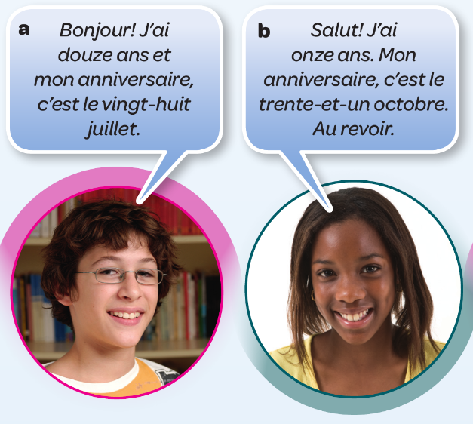
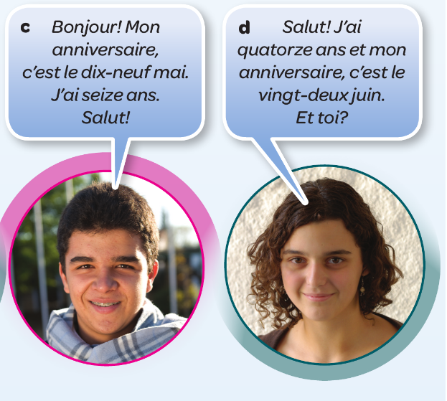
Exercise de lecture – Studio page 9
Read the texts. For each person, write down their age and birthday in English.
You can type these sentences in Google Translation and you can listen to their pronunciation!

Slide 18
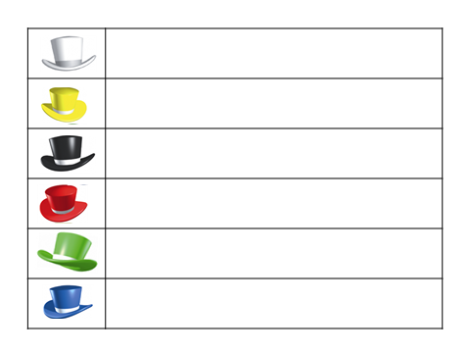
Do you feel ready to join a French class? Write your thoughts in this grid.
What did you learn?
What went well? Did you find it easy to memorise the vocabulary?
What did you find difficult? (spelling, pronunciation, etc…?
How do you feel about joining a French class after half-term?
What are you going to do to feel ready for this new subject?
Which habits of Excellence are you going to use in your French lessons?

